Slide 1


Predicting FIFA Player Ratings Using Key Attributes

Slide 2
Introduction:
This project aims to predict FIFA player ratings using key attributes, offering valuable insights for both game developers and sports analysts. Accurate player ratings contribute to a more realistic and immersive gaming experience, while helping users make better decisions in both the virtual and real-world sports analysis contexts. By understanding which player attributes most influence the overall rating, our study strives to refine player assessment models, ultimately enhancing gameplay realism.

Slide 3
Research Questions
How do key performance metrics (e.g., pace, shooting, passing) influence a player's overall rating in professional sports, and which attributes have the most significant impact?
How does the performance of polynomial regression compare to multiple linear regression in terms of predictive accuracy for player ratings, and does the inclusion of non-linear terms lead to significant improvements?
How effective are cross-validation and external validation methods in evaluating the stability of regression models for predicting player ratings?

Slide 4
Data Description
Data Source: Kaggle FIFA Player Dataset (Filtered to 18,000 players from the latest FC24 version)
Attributes:
Player Positions: Roles in both club and national teams
Player Skills: Attributes like Dribbling, Passing, Speed, Defense, and Mentality
Player Personal Data: Information including Nationality, Club, Age, Wage, etc.
Response Variable: Overall player rating
Predictor Variables: Key attributes selected to predict ratings, such as:
Dribbling, Passing, Pace, Shooting, Defending, Physic, Week Foot, Skill Moves, Age, Value and Wage

Slide 5
Abstract:
Our study focuses on predicting FIFA player ratings by analyzing specific player attributes, such as dribbling, passing, and speed. Using a filtered FIFA dataset of 18,000 players from the latest FC24 version, we aim to build predictive models that incorporate both multiple linear and polynomial regression techniques. By exploring linear and non-linear relationships, we aim to uncover which attributes best predict a player’s overall rating. The project leverages interaction and second-order terms to capture complex attribute dynamics, with models evaluated based on R-squared and Mean Squared Error (MSE) metrics for optimal accuracy.

Slide 6
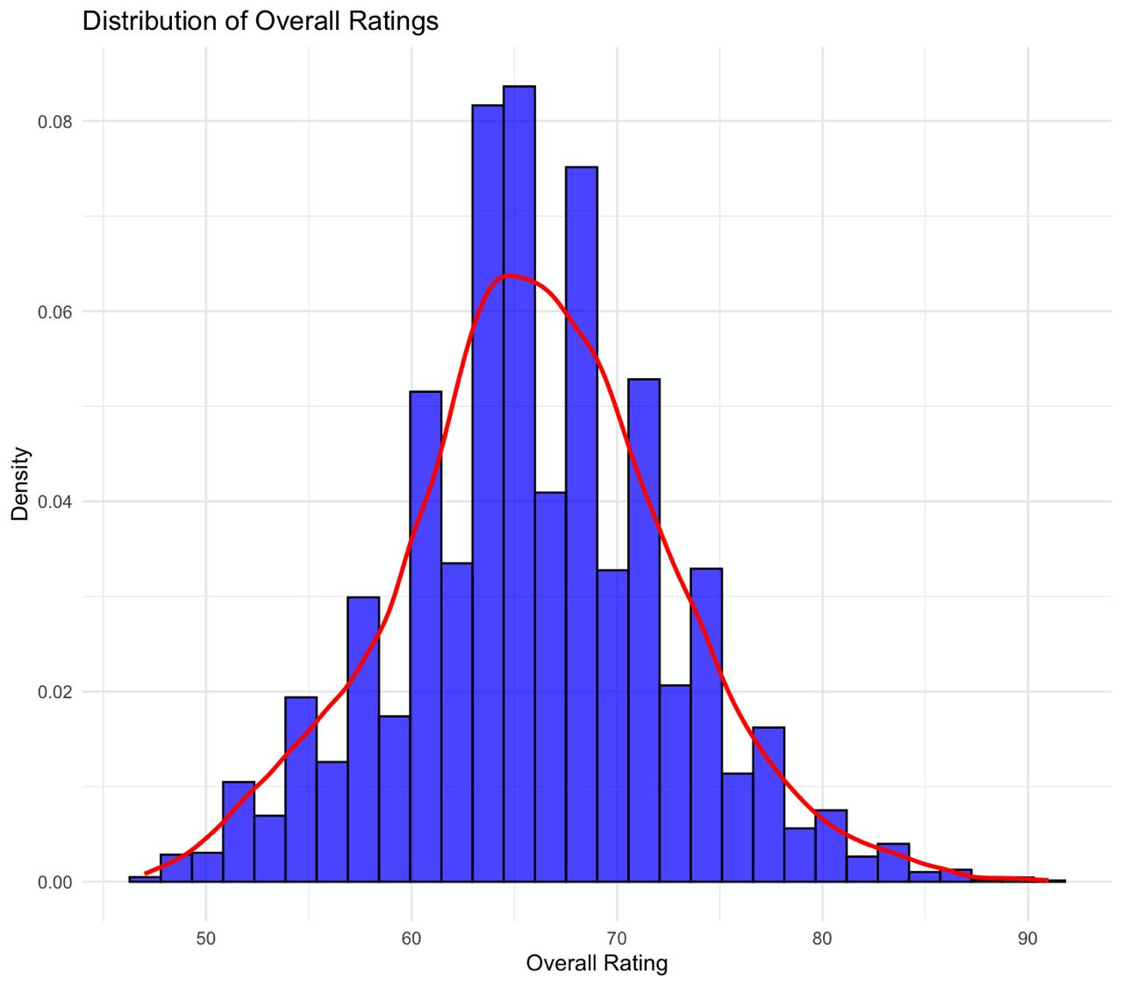
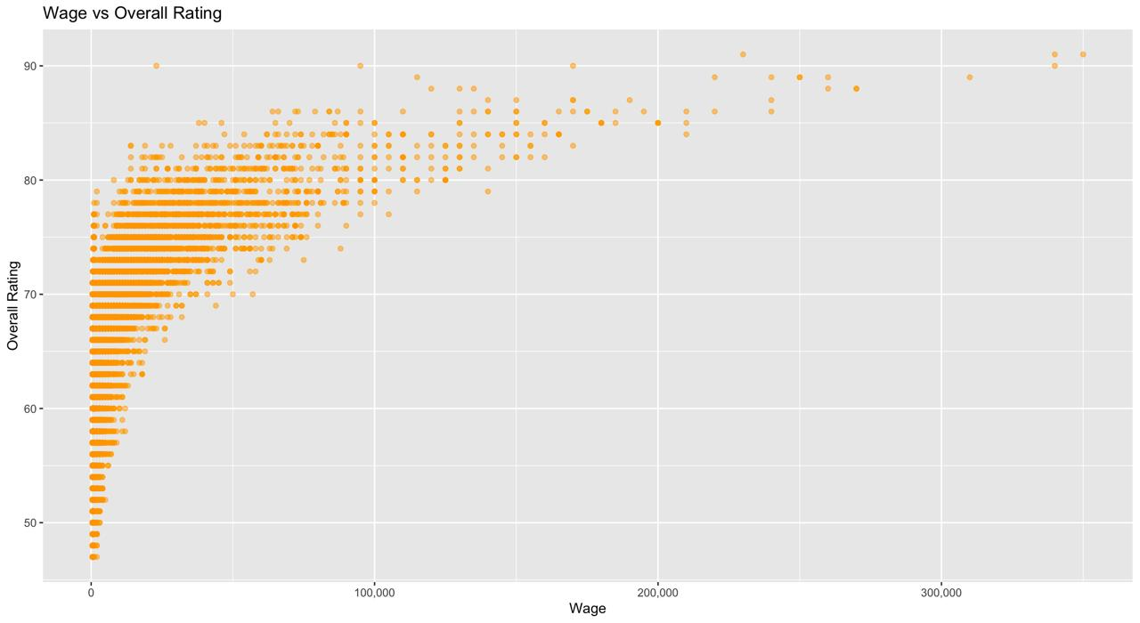
EXPLORATORY DATA ANALYSIS

Slide 7
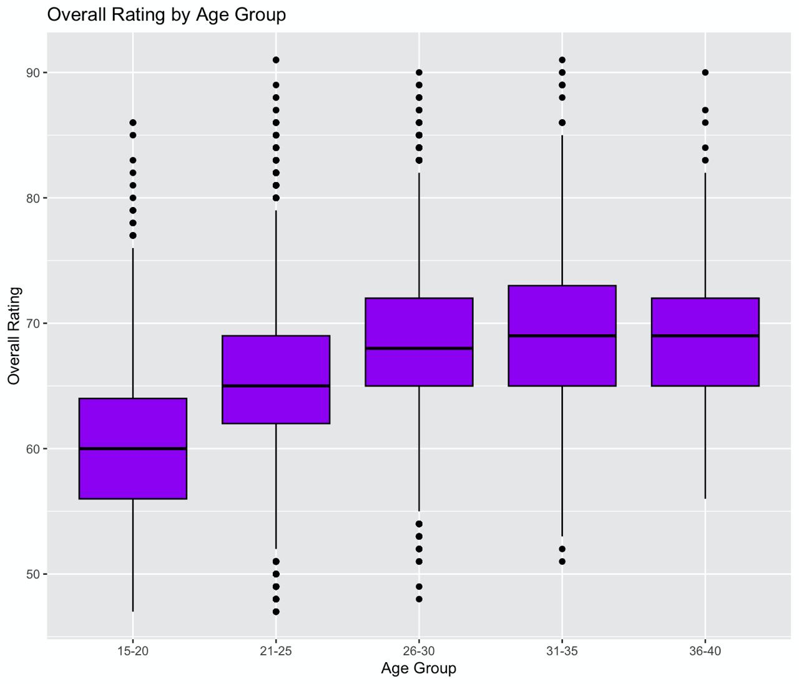
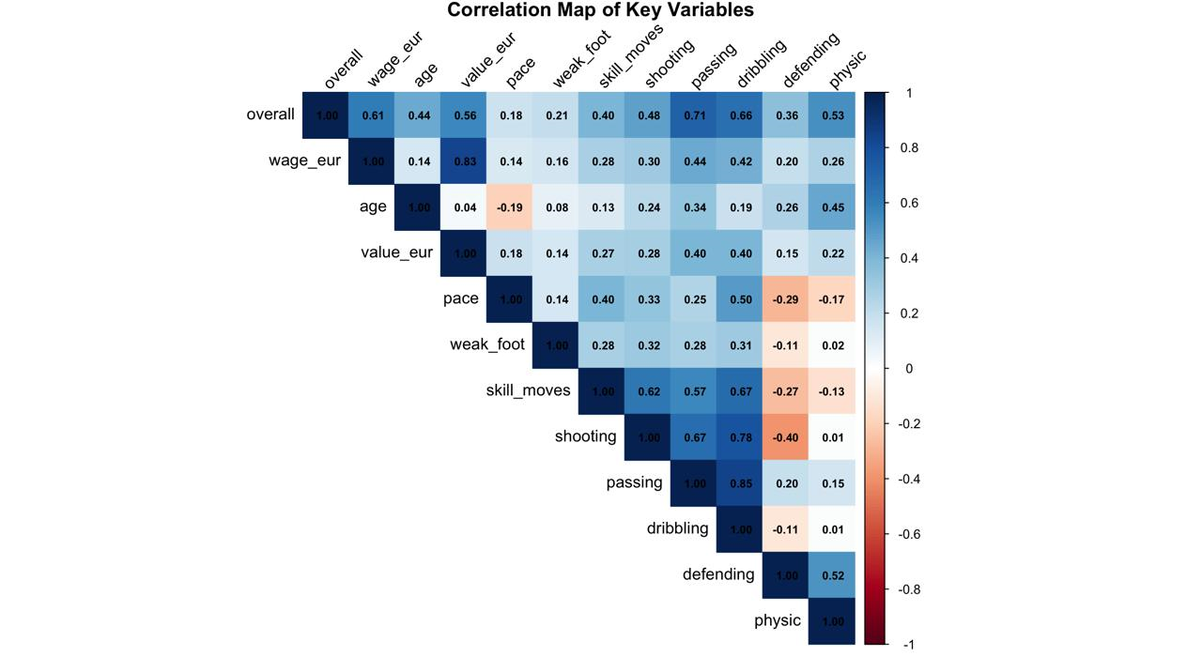

Slide 8
MODELS
Multiple Linear Regression
Polynomial Regression

Slide 9
Multiple Linear Regression
Predicting Player Ratings with Multiple Linear Regression
Objective: Predict overall player rating using key attributes, including financial (wage_eur) and skill metrics (dribbling, physic, etc.).
Model Performance:
R-squared: 0.8018 (80% variance explained)MSE: 8.92 (indicating good predictive accuracy)
Key Insights:
Significant Predictors: dribbling, physic, and wage_eur contribute strongly to overall rating.Impact: Highlights the importance of both technical skills and financial investment in player valuation.

Slide 10
Polynomial Regression
Polynomial Regression (Degree 2) with Linear Terms
Objective: Use polynomial regression (second-degree) to predict overall player ratings, focusing on both financial and skill-based features.
Model Performance:
R-squared: 0.9542 (95% of variance explained)MSE: 2.06 (higher precision than linear regression)
Key Insights:
Significant contributors include wage_eur, age, and complex skill interactions.
Higher accuracy: Incorporating non-linear relationships among skill metrics results in improved predictive power.
Interpretation: The model captures complex interactions in player skills and financial metrics, offering a more nuanced view of player ratings than linear regression.

Slide 11
External validation
Polynomial Regression Model – External Validation Results
Polynomial Regression Model – 10-Fold Cross-Validation Results

Slide 12
Polynomial Regression Model – External Validation Results
Data Splitting Strategy:
Training (60%) – Model
Training Validation (20%) – Model Tuning
Test (20%) – External Validation
Key Performance Metrics:
Training:
R² = 0.9539
MSE = 1.437
Validation:
R² = 0.9556
MSE = 2.02
Test:
R² = 0.9529
MSE = 2.15
Conclusion:
High R² and low MSE across all sets demonstrate strong predictive accuracy and generalizability of the polynomial regression model, indicating effective capture of non-linear relationships in player ratings.

Slide 13
Polynomial Regression Model – 10-Fold Cross-Validation Results
Objective: Assess model reliability through 10-fold cross-validation.
Performance:
Mean MSE: 2.08 (low error, close predictions)Mean R-squared: 0.954 (captures 95.4% variance)
Conclusion: Strong model consistency and accuracy in predicting player ratings across folds, demonstrating effective handling of non-linear relationships.

Slide 14
Residual analysis
QQ Plots
Objective: Assess normality of residuals.
Insights: Residuals closely follow the normal line across training, validation, and test sets, with minor deviations in the tails, indicating approximate normality.
Histograms of Residuals
Objective: Visualize residual distribution.
Insights: Residuals show a bell-shaped curve around zero, suggesting a normal distribution across all datasets.
Residuals vs. Fitted Values
Objective: Check for constant variance (homoscedasticity).
Insights: Residuals scatter evenly around zero without clear patterns, indicating homoscedasticity, supporting model assumptions.
Conclusion:
The residual analysis supports that the polynomial regression model captures data patterns well, with approximately normal and homoscedastic residuals across training, validation, and test datasets, affirming model reliability.

Slide 15
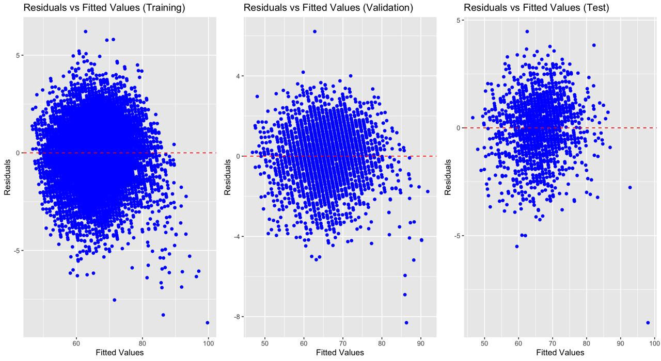
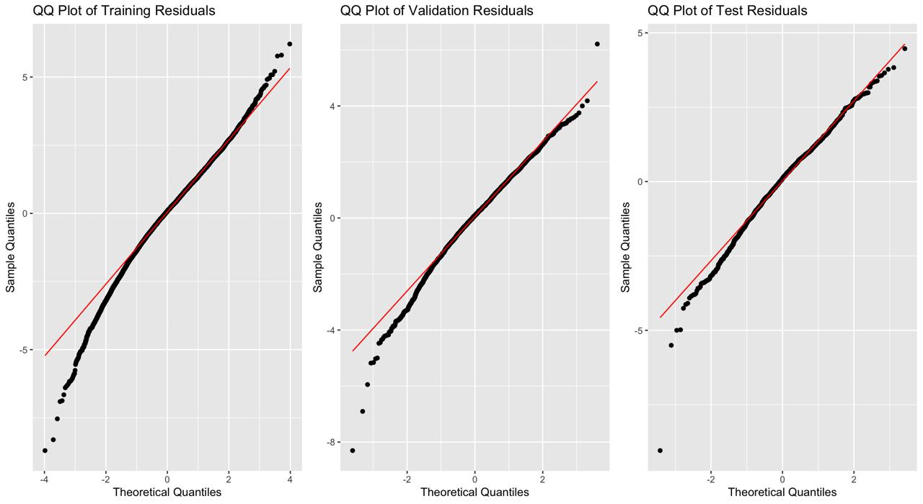
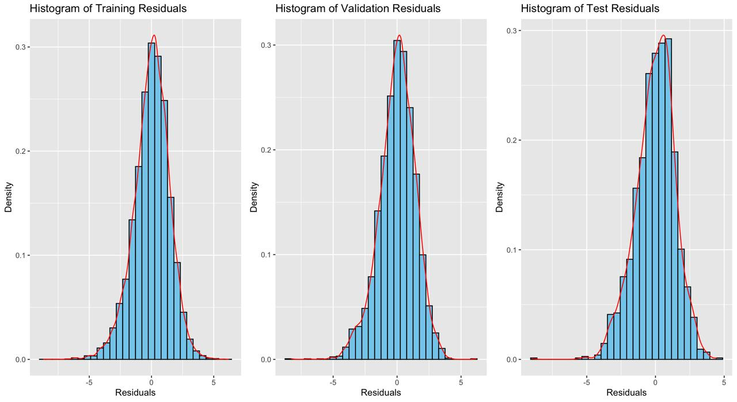

Slide 16
RESULTS

Slide 17
How do key performance metrics (e.g., pace, shooting, passing) influence a player's overall rating in professional sports, and which attributes have the most significant impact?
Impact of Key Performance Metrics on Player’s Overall Rating
Most Influential Metrics: Dribbling and Physic have the strongest positive impact on a player’s overall rating.
Skill Moves, Shooting, and Passing also significantly enhance a player's rating, showcasing the importance of technical and physical abilities.
Less Influential: Pace shows a minimal effect on overall rating, indicating that speed is valued less than technical and physical skills.
Conclusion: Technical skill, physicality, and versatility are prioritized, with Dribbling and Physic emerging as the most valued metrics in determining overall player rating

Slide 18
How does the performance of polynomial regression compare to multiple linear regression in terms of predictive accuracy for player ratings, and does the inclusion of non-linear terms lead to significant improvements?
Polynomial vs. Multiple Linear Regression for Player Ratings
Accuracy: Polynomial Regression (MSE = 2.06, R² = 0.95) significantly outperforms Multiple Linear Regression (MSE = 8.91, R² = 0.80).
Impact of Non-linear Terms: Adding squared terms captures complex relationships, enhancing model fit and predictive accuracy.
Conclusion: Polynomial Regression is more effective for predicting player ratings due to its ability to model non-linear interactions between performance metrics.

Slide 19
How effective are cross-validation and external validation methods in evaluating the stability of regression models for predicting player ratings?
Model Stability: Cross-Validation & External Validation
Cross-Validation (10-Fold)Purpose: Assesses model consistency across data subsets.
Results: MSE ~2.08, R² 0.95 — strong generalization, low variance.
External ValidationPurpose: Tests performance on unseen data.
Results: MSE 2.15, R² 0.95 — mirrors training, confirms robustness.
Key Takeaway: Both methods confirm model stability and reliability, ensuring it generalizes well for accurate player rating predictions.

Slide 20
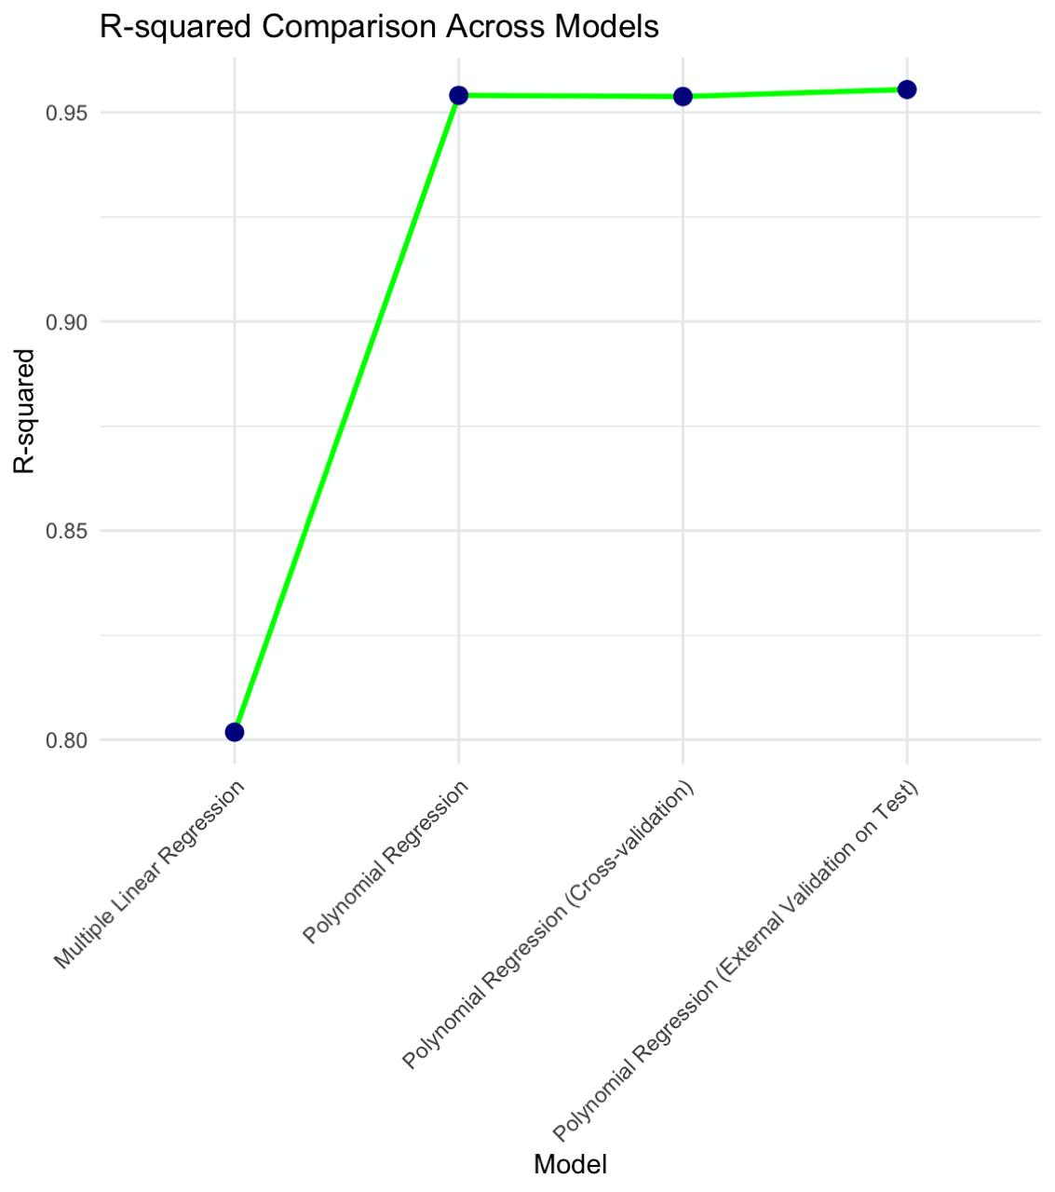
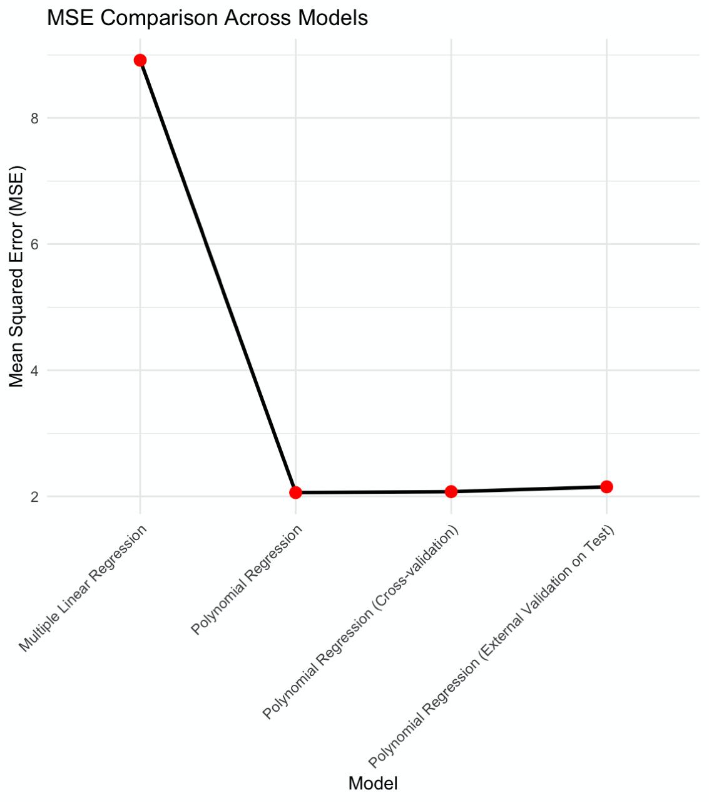


Slide 21
CONCLUSION
Polynomial Regression is the optimal model for predicting player ratings, outperforming Multiple Linear Regression with a higher R-squared (~0.95) and significantly lower MSE (~2.06–2.15).
It demonstrates strong predictive accuracy and stability across training, cross-validation, and external test sets, making it reliable for real-world applications.

